Slide 1
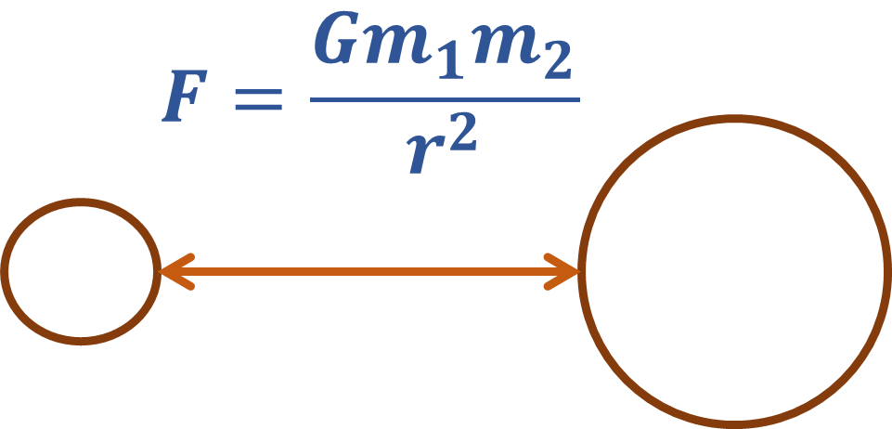
Bridging Practice and Theory in SAT: Moshe Vardi the Catalyst
Sharad Malik
Electrical and Computer Engineering
Princeton University

Slide 2
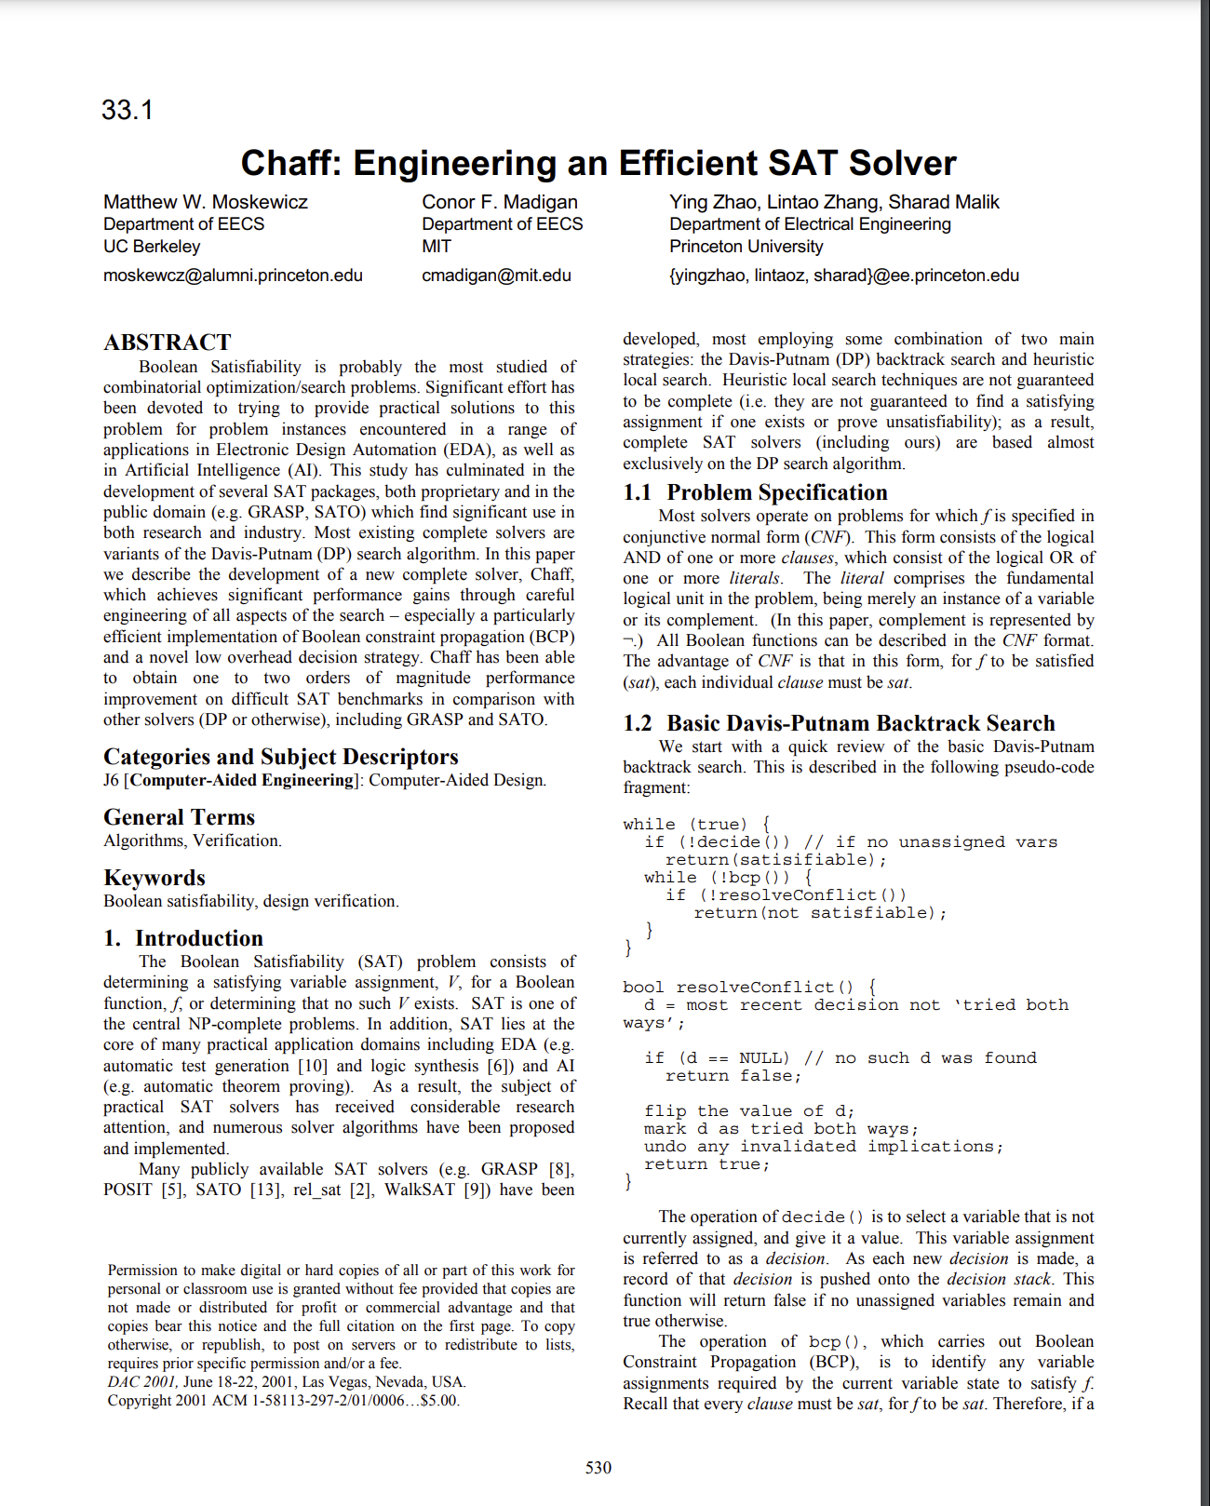
Boolean Satisfiability Solvers
DAC 2001
Algorithmic contributions
Efficient Boolean Constraint Propagation (BCP), aka Unit Propagation
“Two-literal watching”
Low bookkeeping overhead on variable assignment
Constant time “backtracking”
Low overhead decision heuristic
Variable state independent decaying sum (VSIDS)
Locality based search

Slide 3
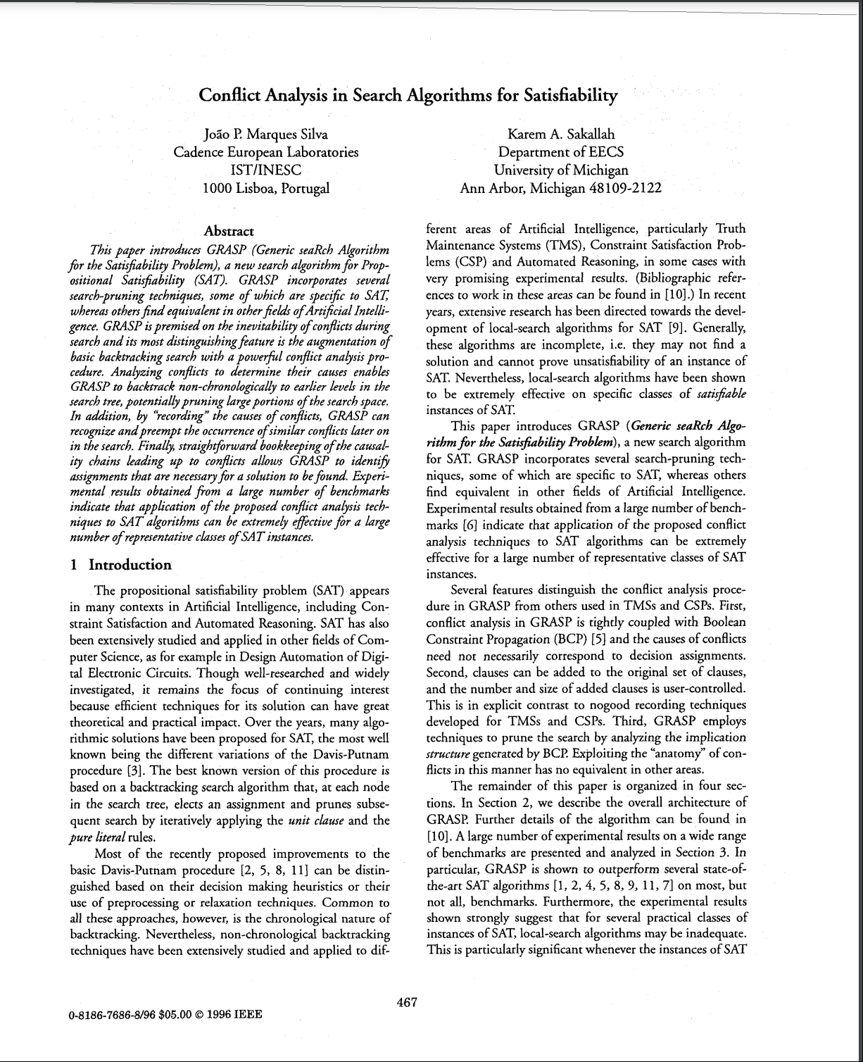
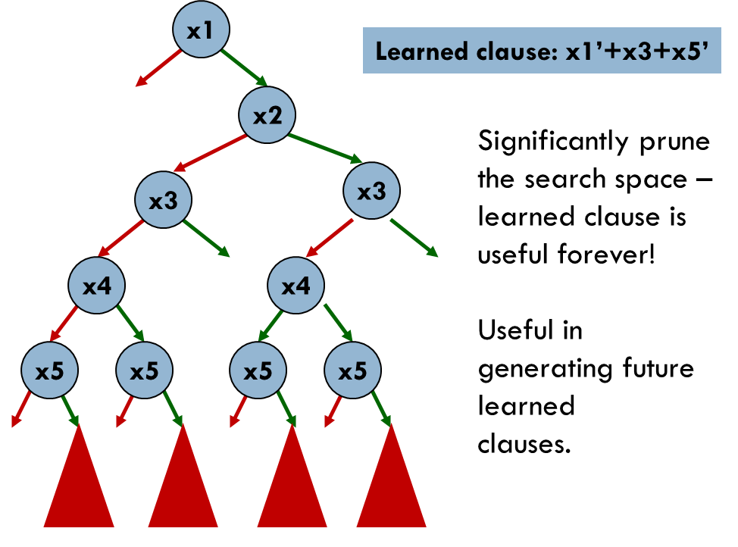
Boolean Satisfiability Solvers
ICCAD 96
Standing on the shoulders of giants…
Conflict Driven Clause Learning (CDCL)
GRASP SAT Solver (ICCAD 1996)
Analysis of conflicts
Learned clauses

Slide 4
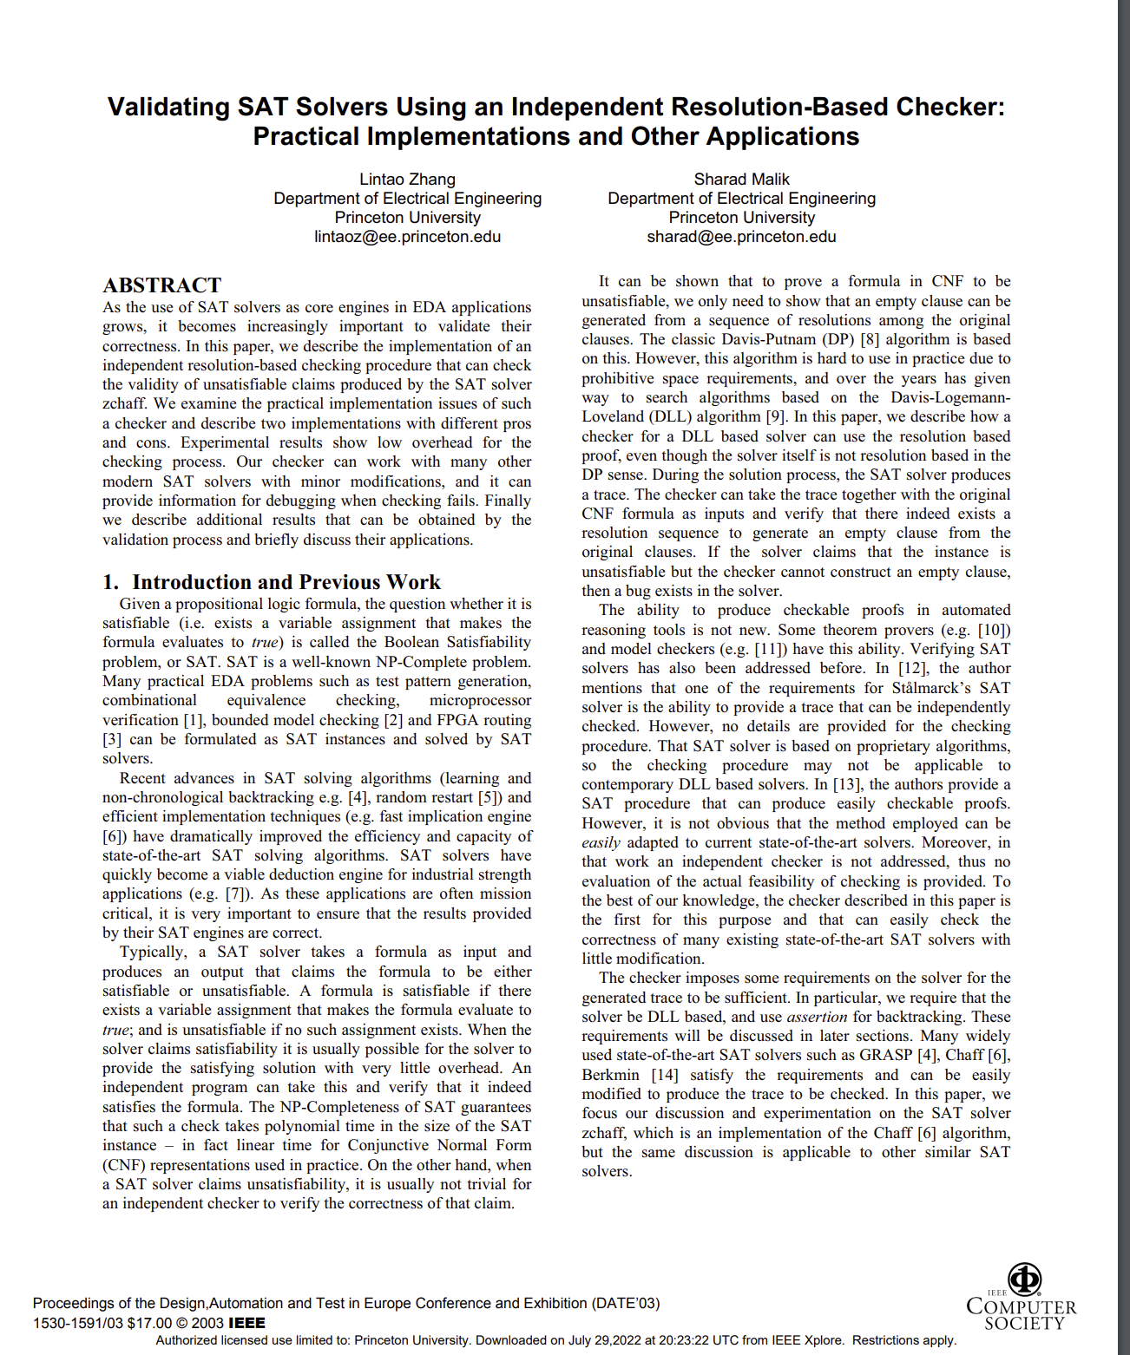
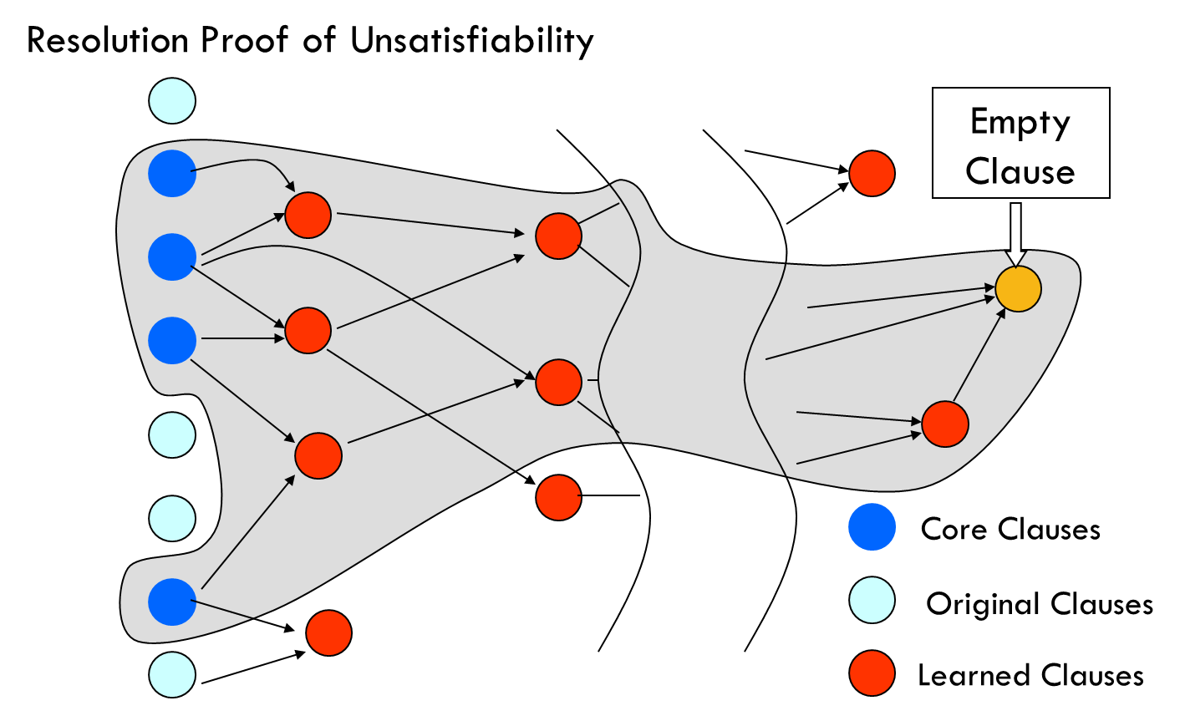
Boolean Satisfiability Solvers
DATE 2003
UNSAT proof logging
Independent checking of solver proofs
UNSAT core from resolution proofs
Many applications

Slide 5
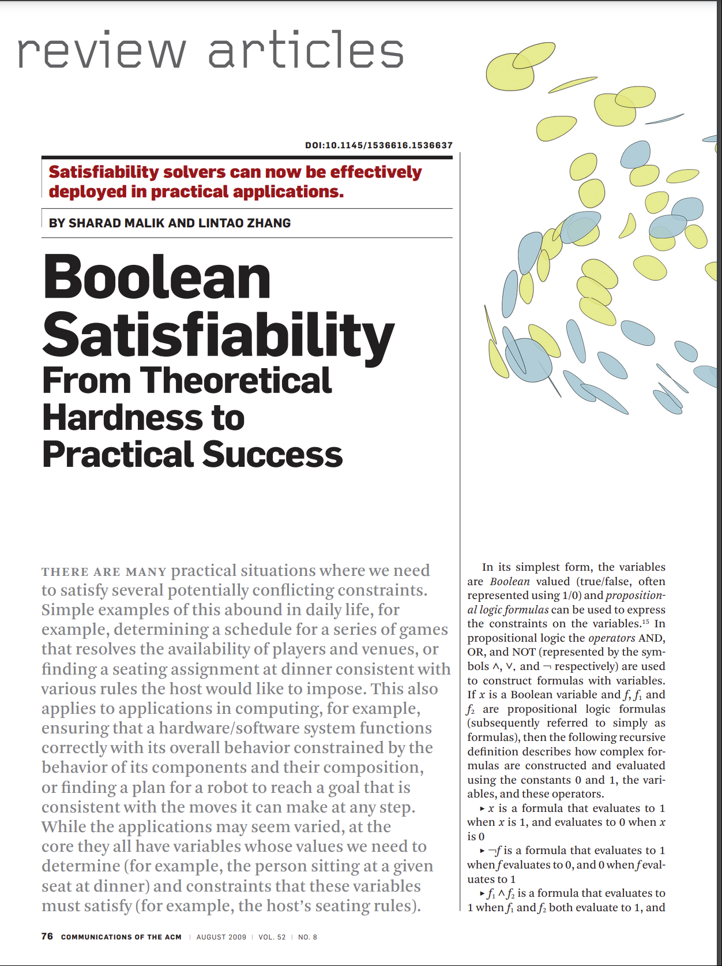
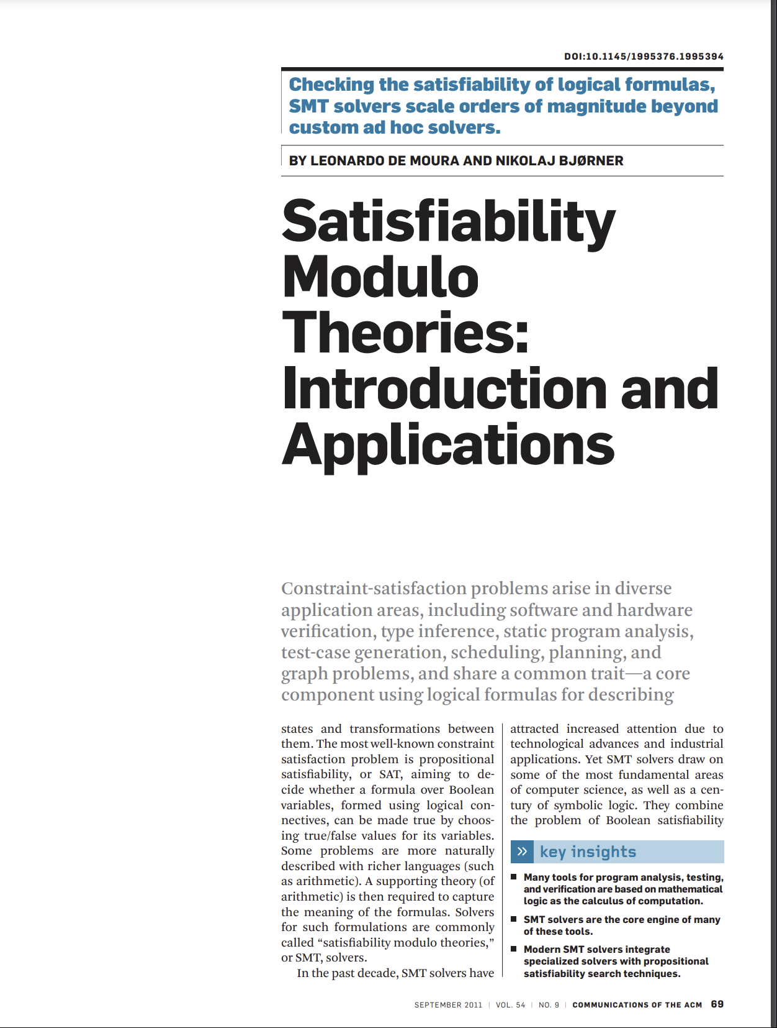
Moshe as CACM Editor-in-Chief: Serving the Community
CACM 8/2009
CACM 9/2011

Slide 6
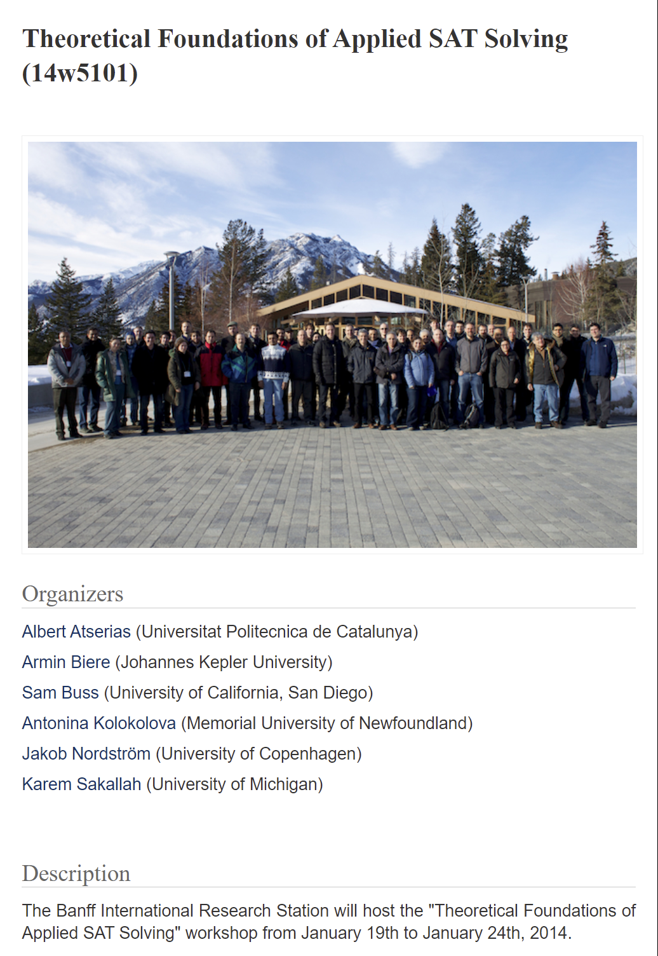
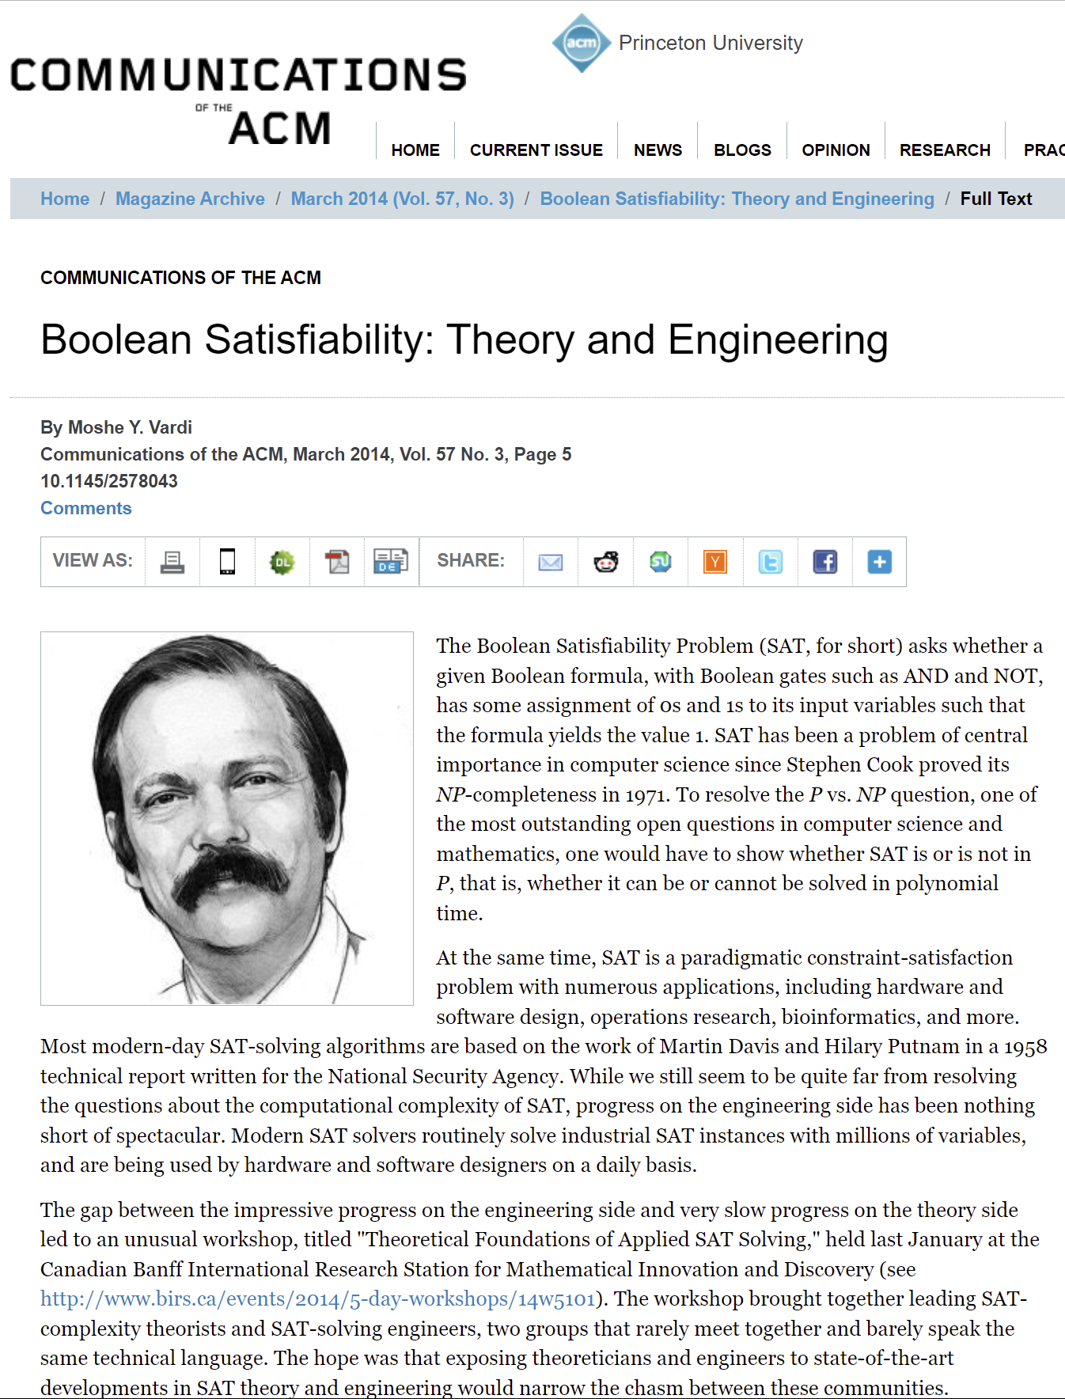
Shepherding a Community
The workshop brought
together leading
SAT-complexity theorists
and SAT-solving engineers,
two groups that rarely
meet together and barely
speak the same technical
language. The hope was
that exposing theoreticians
and engineers to state-of-the-art developments in SAT theory
and engineering would narrow
the chasm between these
communities.

Slide 7
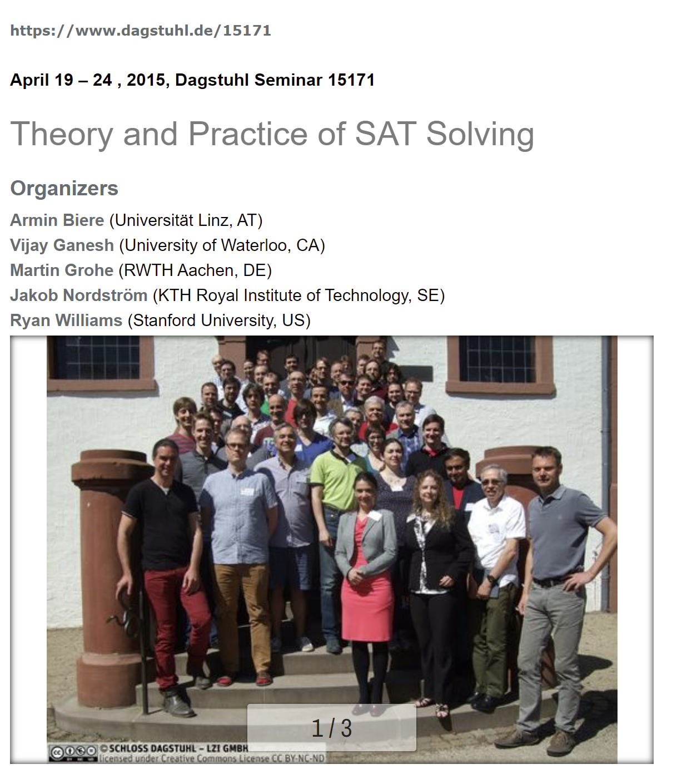
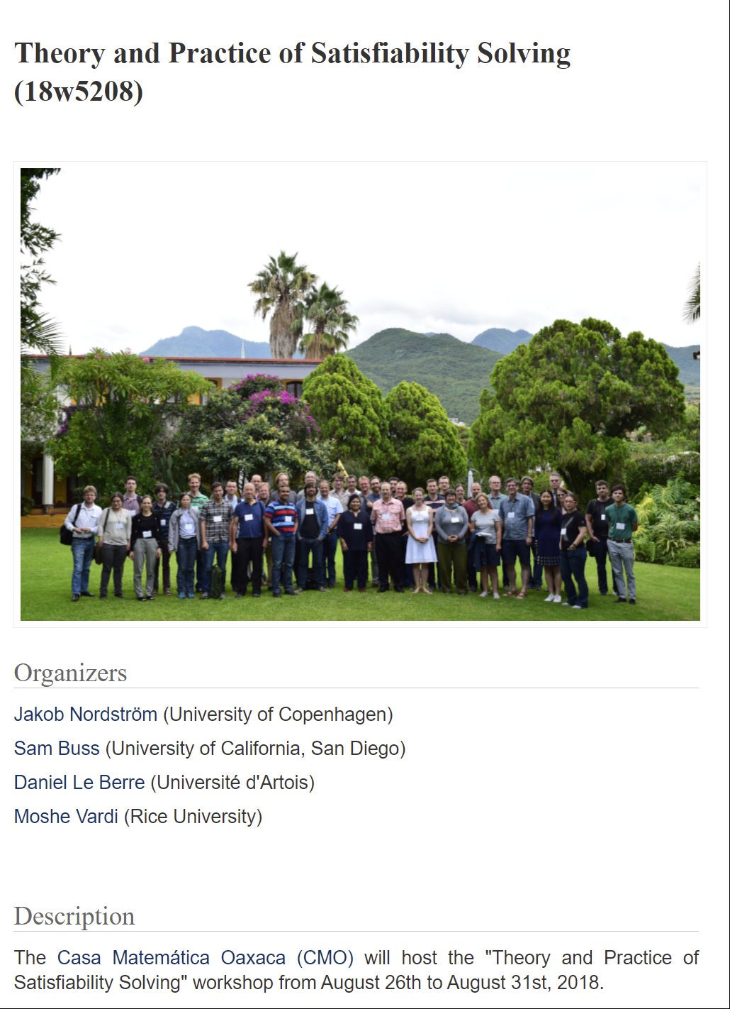
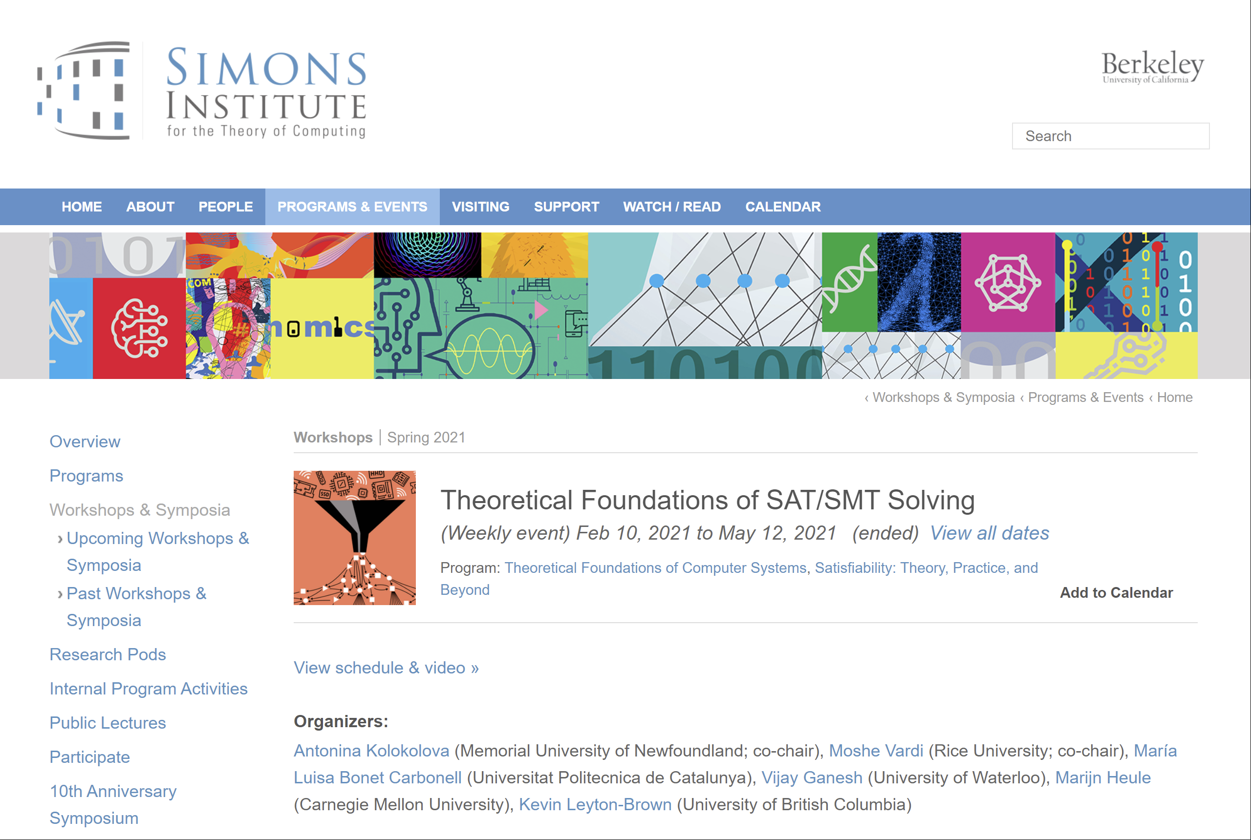
Shepherding a Community

Slide 8
Shepherding a Community

Slide 9
Shepherding a Community

Slide 10
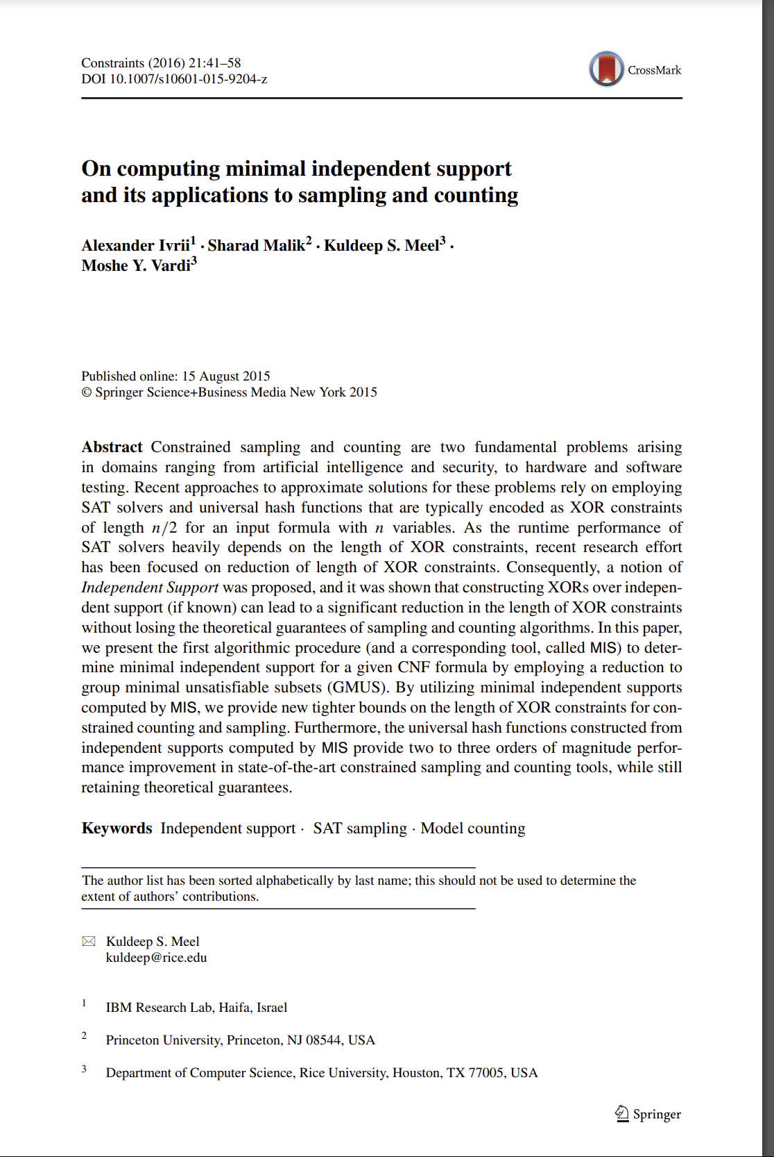
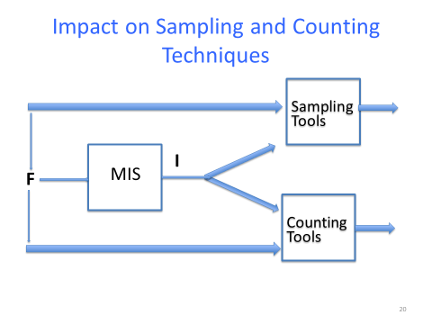
Finally – my Vardi number is 1!
Constraints 2016
CP 2015
[Slide source: K. Meel]

Slide 11
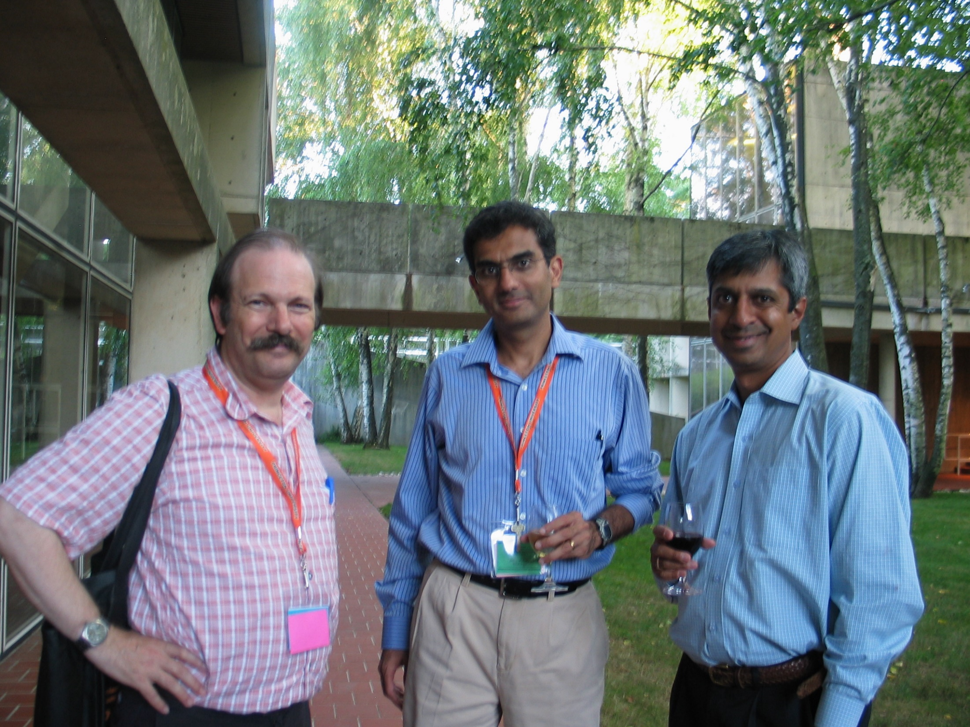
CAV 2008
Princeton
Dhanyavad!
Thank you!
Toda raba!

